Slide 1
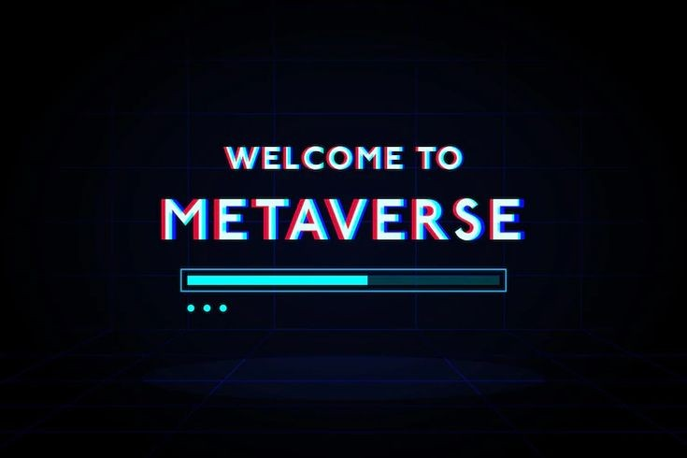

1

Slide 2
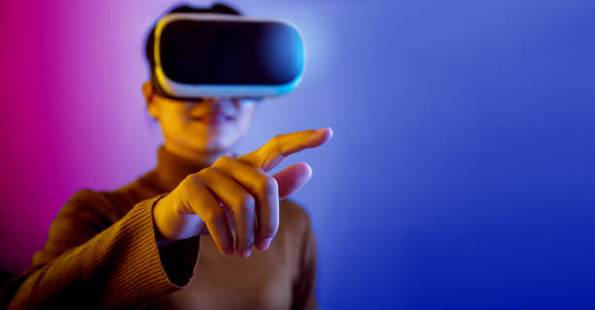



PRESENTED BY:-
Shawon Gazi
241400031
Siam Ahmed
241400032
Afroza Binte Ansarul
241400042
10

Slide 3
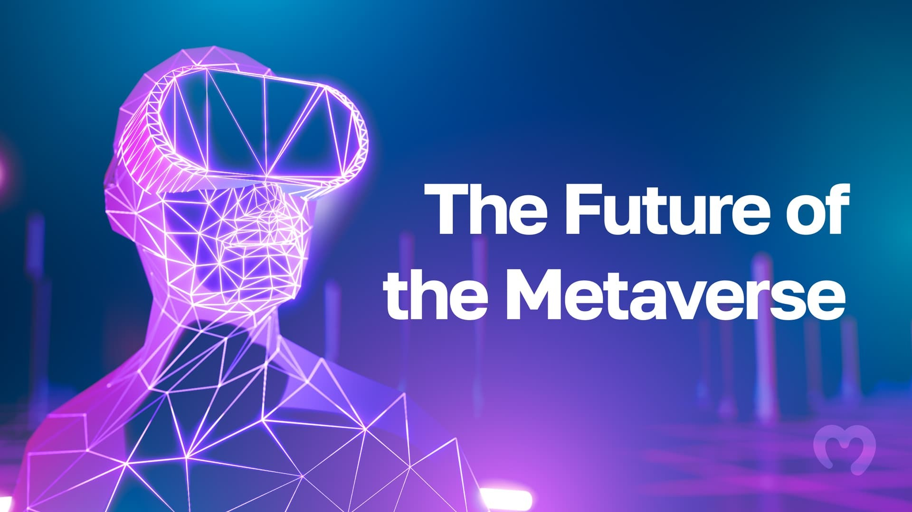
10

Slide 4
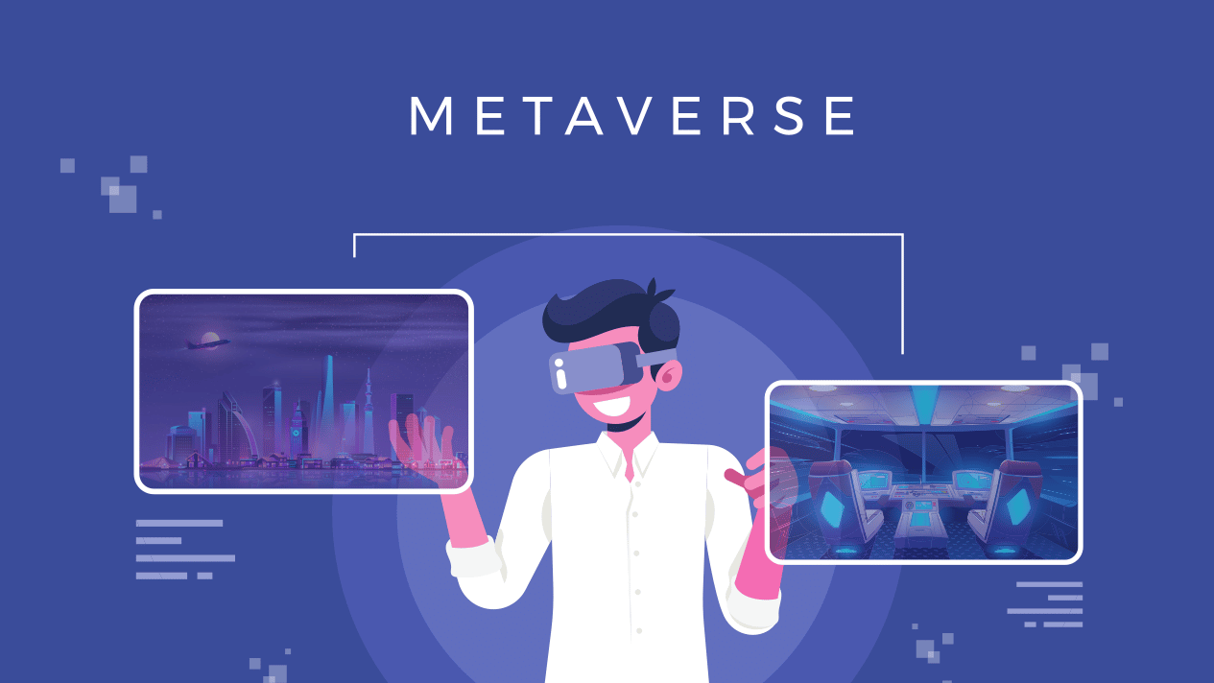
10

Slide 5

CONTENTS
01
INTRODUCTION
02
HISTORY
03
HOW IT WORKS
04
TECHNOLOGIES USED
05
APPLICATIONS
06
ADVANTAGES
07
LIMITATIONS
08
REFERENCES
10

Slide 6

What Is Metaverse ?
INTRODUCTION
A metaverse is a shared, online 3D space where users can interact with each other and with computer-generated objects and avatars. It is a virtual world that uses the Internet as its underlying network. Metaverses are used for various purposes, including social networking, online gaming, education, and training. They can be used to create virtual worlds that mirror the real world, or they can be used to create entirely new and imaginary worlds.
10

Slide 7
HISTORY OF METAVERSE
Metaverse may have become the buzzword only recently, but it is well-known Tim Berners-Lee invented the World Wide Web (www) in 1989. Then in 1992, sci-fi writer Neal Stephenson coined the term 'metaverse' to describe a 3D virtual space. Fast forward to 2022, the metaverse is a digital world created using different technologies like Virtual Reality (VR), Augmented Reality (VR), and cryptocurrency, and the Internet.
However, a lot happened in these 30 years, from Philip Rosedale's 'Second Life' online virtual world in 2003 to Mark Zuckerberg's 2021 announcement of Meta's (formerly Facebook) metaverse plan.
10

Slide 8
1989
1992
2006
2009
HISTORY OF METAVERSE
Roblox, an online platform that allows users to create and share games with others, is introduced.
Tim Berners Lee invents the World Wide Web (www).
Science fiction writer Neal Stephenson uses the term 'metaverse' to describe a 3-D virtual space.
Bitcoin, the world's first successful cryptocurrency and blockchain platform is created.
10

Slide 9
2014
2016
2021
HISTORY OF METAVERSE
Microsoft unveils Mesh, a platform designed for virtual collaboration across multiple devices.
Facebook acquires virtual reality hardware and platform Oculus.
Mark Zuckerberg says Facebook's parent company would adopt the name Meta and unveils plans for their metaverse.
Pokemon Go, a game that uses augmented reality technology, takes the world by storm.
10

Slide 10
HOW IT WORKS ?
Metaverse is a network of simulated digital environments with its main focus on social connection. It uses persistent virtual worlds, blockchain, and augmented reality to create spaces for interaction online. This is facilitated by mobile internet as well as augmented and virtual reality headsets.
In the Metaverse, users can have an immersive experience on the internet by generating a three-dimensional image that surrounds them.
This experience is impossible without using virtual reality, a key component of the Metaverse, where users get to experience both digital and real-world in the same space.
10

Slide 11
An immersive experience draws users into an imagined space that permits them to manipulate and relate to their environment. It involves a blend of visuals, technology, and sound to deliver extraordinary and engaging worlds.
Immersive experiences are just like the typical experiences that you feel during your daily activities. Some of them include enjoying a concert, having an offsite meeting, watching a movie, learning with your friends, etc.
10

Slide 12
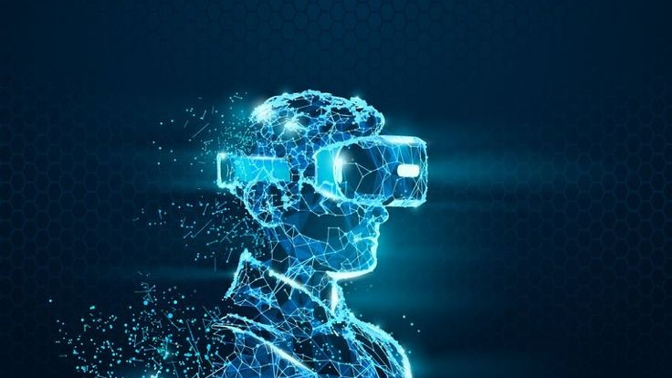
TECHNOLOGIES USED ?
Blockchain
Virtual Reality
Augmented Reality
Artificial Intelligence
Internet Of Things
3D Reconstruction
10

Slide 13

BLOCKCHAIN
Blockchain technology is used to establish the decentralized network of virtual worlds and 3D spaces known as Metaverse. Anyone can utilize the user-friendly Metaverse platform to build their own virtual world or 3D environment. It is a place where people can connect in all facets of their lives.
10

Slide 14

ARTIFICIAL INTELLIGENCE
Artificial intelligence (AI) is the ability of a computer or a computer-controlled robot to perform tasks that are usually done by humans as they require human intelligence.
Avatars
Digital Humans
Language Processing
10

Slide 15
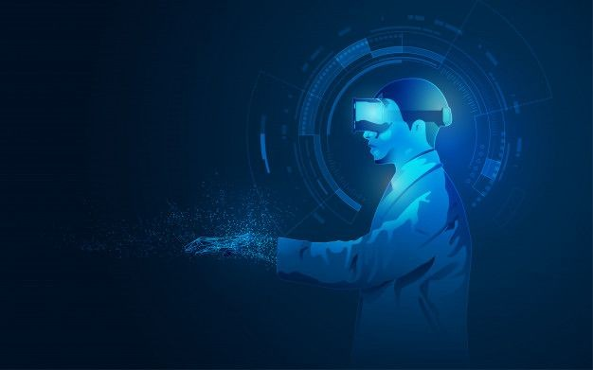
VIRTUAL REALITY
VR refers to a 3D and computer-generated virtual environment either to replicate a real environment or an imaginary world, which is created by a combination of realistic sounds, images and other sensations through devices like VR headsets/helmets, gloves and body detectors equipped with sense detectors.
10

Slide 16
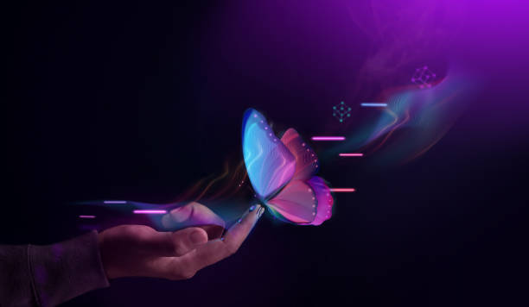
AUGMENTED REALITY
AR is a live view of a physical environment with its elements augmented by the digital sensory input like sound, graphics, videos or GPS data. In other words, AR exists on top of our physical world by allowing users to see the actual environment through the screens of their phones/ tablets or by using smart glasses and making virtual changes to it on the screen. Through the cameras of phones/ tablets or the smart glasses, the apps can put an overlay of the digital content into our actual environment.
10

Slide 17
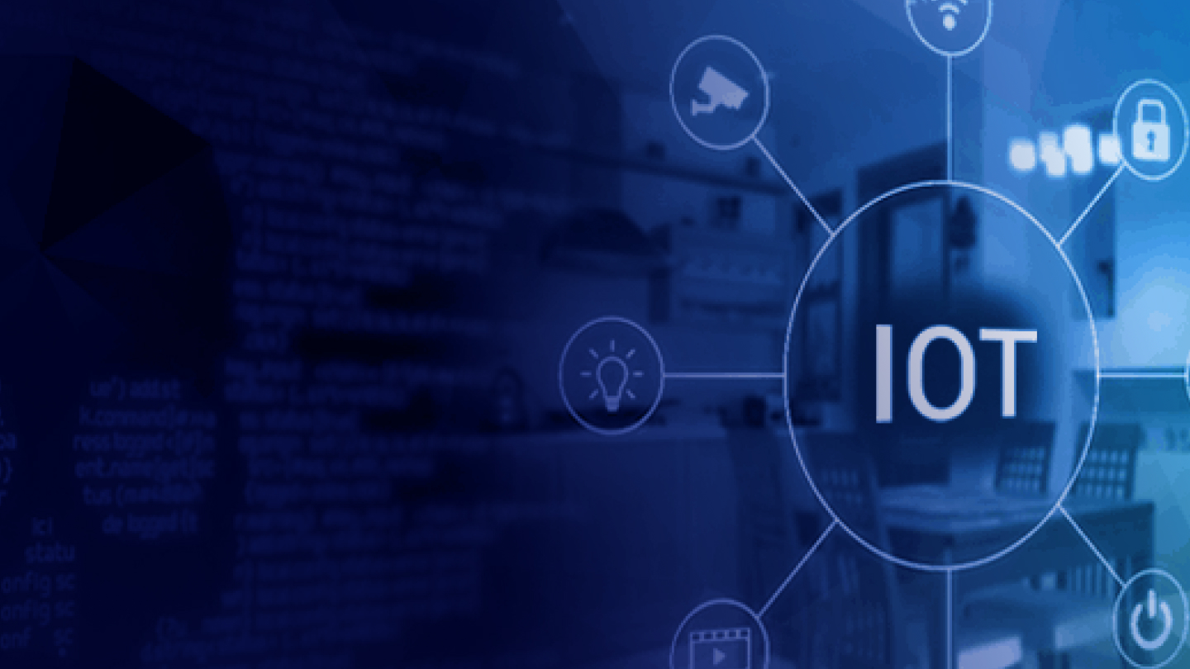
3D Reconstruction & Internet Of Things
3D Reconstruction is the creation of 3D objects in virtual spaces.
IOT is basically the interconnection of everyday things via the internet. It involves the intelligent connection of devices, home appliances, vehicles and the like through pieces of tech that have software and allows these items to connect and interrelate with each other. This is especially important for the Metaverse as it would be vital in translating and converting accurate data from the physical world to the digital world. With IOT, the virtual world of the Metaverse would be able to properly reflect properties of the physical world including real-time changes to these objects. Steps should be taken to protect this interconnection through safeguards from and in case of cyber attacks.
10

Slide 18
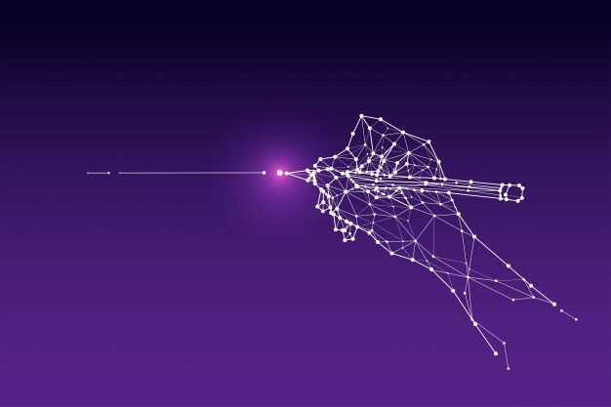
APPLICATIONS OF METAVERSE :
Healthcare
Education
Real Estate
Military
Manufacturing
Gaming
Banking & Finance
10

Slide 19
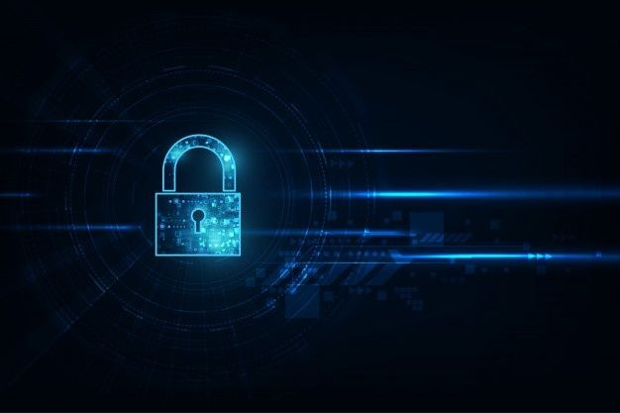
ADVANTAGES :
Immersive experience
Better social interactions online
New business opportunities
Improvements to online learning and education
Improvements to gaming
Upgrading social media
10

Slide 20

LIMITATIONS :
Privacy Issues
Protecting Our Kids
Health Concerns
Access Inequality
10

Slide 21
REFERENCES :
https://www.mygreatlearning.com/blog/what-is-metaverse/
https://www.cnbctv18.com/technology/explained-the-history-of-metaverse-12015212.htm
https://101blockchains.com/technologies-powering-metaverse/
https://cyberscrilla.com/metaverse-pros-and-cons-the-top-benefits-and-drawbacks/
https://blog.servermania.com/what-is-metaverse/#:~:text=Metaverse%20is%20a%20network%20of,augmented%20and%20virtual%20reality%20headsets.
10

Slide 22
https://aristeksystems.com/blog/5-key-metaverse-technologies/#:~:text=3D%20Reconstruction,the%20wake%20of%20the%20pandemic.
https://medium.datadriveninvestor.com/the-roles-of-vr-ar-and-mr-on-the-metaverse-593569cfb686
10

Slide 23
10

Slide 24

10

